Slide 1
Relay User Manual

Slide 2
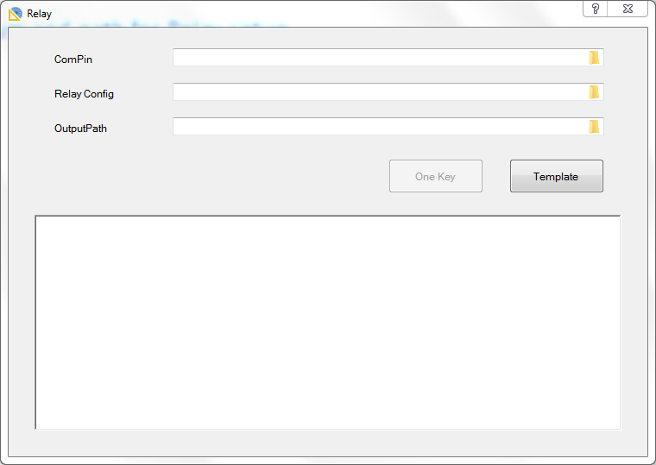
Relay Generator
Purpose
To define Device Pin => Resource Pin and search the relay in this path.
To generate Relay Enum and path for Relay setup.
GUI

Slide 3
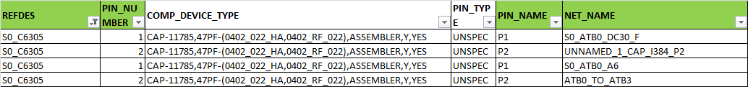
Relay Generator
Component_pin_report Format
REFDES/PIN_Number : It’s one Component and one node in the circuit.
PIN_NAME/ NET_NAME : PinName & NET_Name is the other node in the circuit.
=> User must to define linked rule in LinkedNodeRule sheet (ex.P1=>P2) to tell tool that there are path for P1_S0_ATB0_DC30_F => S0_C6305_1 => P2_UNNAMED_1_CAP_I384_P2

Slide 4
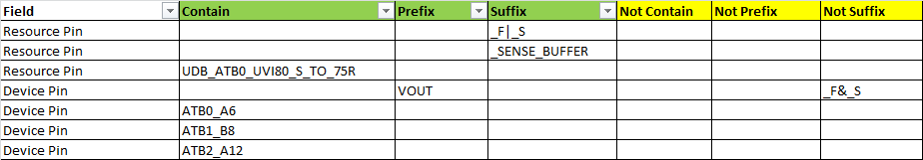
Relay Generator
PinFilter Format in RelayConfig
Field : Only Device Pin and Resource Pin
Contain/Prefix/Suffix/Not Contain/Not Prefix/Not Suffix : To help user to define the Device Pins and Resource Pin, and support “|” and “&” in one single cell.

Slide 5
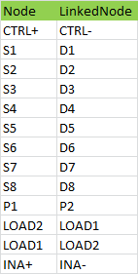
Relay Generator
LinkedNodeRule Format
Node : It means start point.
LinkedNode : It means end point.
=> If there are two paths, user can use
LOAD2=> LOAD1 & LOAD1=> LOAD2 together.

Slide 6
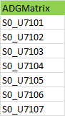
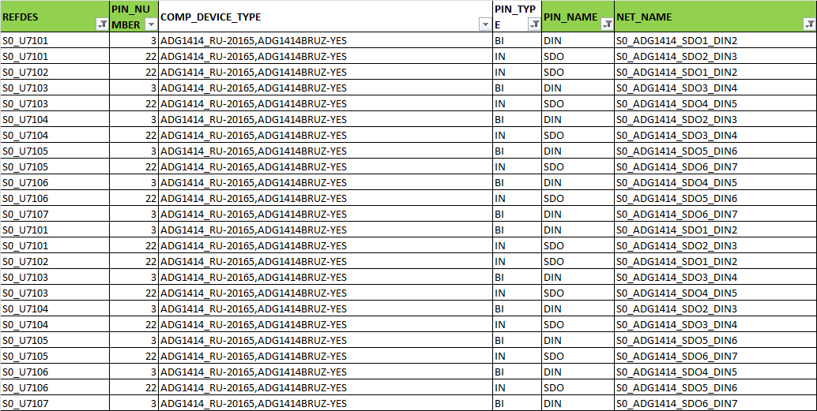
Relay Generator
ADGMatrix Format
Define ADGMatrix and tool will find the sequence
Check PIN_TYPE is “BI” or “IN” and NET_NAME starts with “S0_ADG1414_”
Step 2: S0_U7102
Step 1: S0_U7102
Step 3: S0_U7102

Slide 7
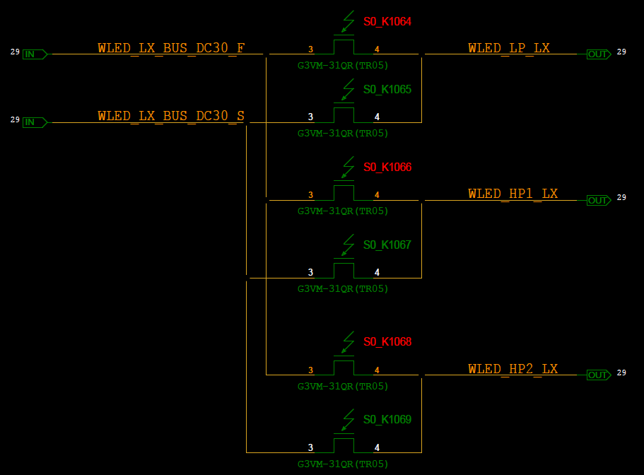
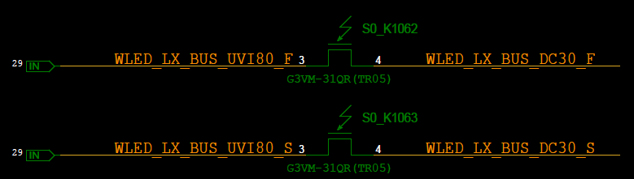
Sample Route on Schematic
0
2
6
WLED_LX_BUS_DC=>
WLED_HP1_LX
➔ Find relay S0_K1066
12
9
3
7
10
4
8
11
5
1
0
14
13
12

Slide 8
Convert into the Tree Diagram and Search by BFS (Breadth-first Search)
0
1
2
3
4
5
6
7
8
9
10
11
12
13
14

Slide 9
Relay Generator
Output
RelaysOnTrace_Enum.txt
RelaysOnTrace_EnumToString.txt
RelaysOnTrace_Case.txt
SIN_Extract.txt
PinToPin *.ini
ADG1414_Matrix : Trace_Based_Relay_Control.xlsx

